Slide 1








PBR Visvodaya Institute of Technology and Science
Detecting and Diagnosing Brain Tumors using ML
Under the Guidance of :
Ms. Guna Gayathri Praseetha K
Asst Professor Presented by :
Dept of C.S.E
Sk. Ajith - 21731A05C1
G. Harichandan - 21731A05E1
M. Bhargav - 21731A05A1
L. Jaya Sankar - 217310596

Slide 2


Contents
Abstract
Introduction
Objectives
Technologies Used
Existing System
Drawbacks
System Architecture
Model Training & Accuracy
Medicine Suggestion System
Hospital Locator Feature
Software Requirements
Hardware Requirements
Base Reference Paper
UML Diagrams
Screenshots
Conclusion

Slide 3



Abstract
Brain tumors are one of the most critical health concerns, requiring timely detection and treatment for better survival rates. Traditional diagnostic methods rely on manual MRI scan analysis, which can be time-consuming and prone to human error. This project presents an automated Brain Tumor Detection and Medicine Suggestion System using Convolutional Neural Networks (CNNs) to classify MRI scans as "Tumor Detected" or "No Tumor Detected". The system aims to accelerate and enhance the accuracy of brain tumor diagnosis, supporting healthcare professionals in the early identification and management of this life-threatening condition.

Slide 4
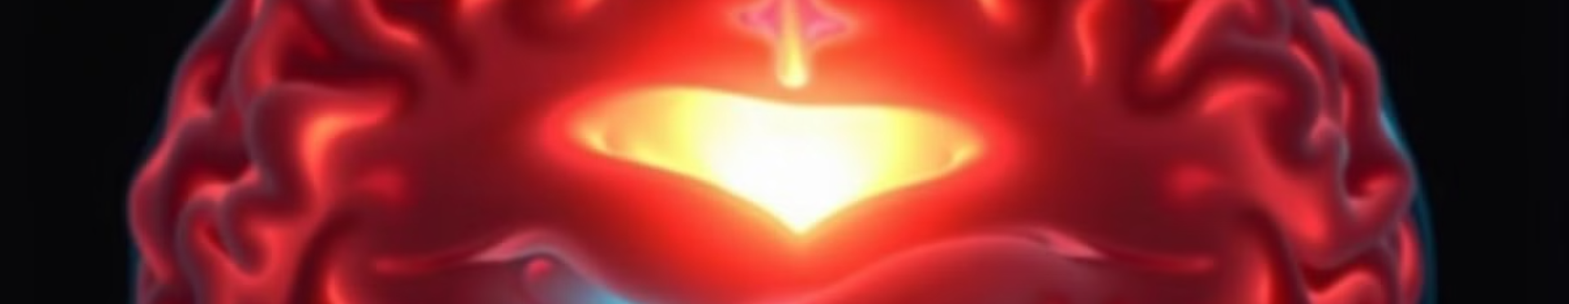


Introduction
Automated Brain Tumor Detection
Convolutional Neural Networks (CNNs)
This project leverages Deep Learning and Image Processing techniques to create an automated Brain Tumor Detection and Medicine Suggestion System.
The system utilizes CNNs to analyze MRI images, classifying them as either "Tumor Detected" or "No Tumor Detected".

Slide 5
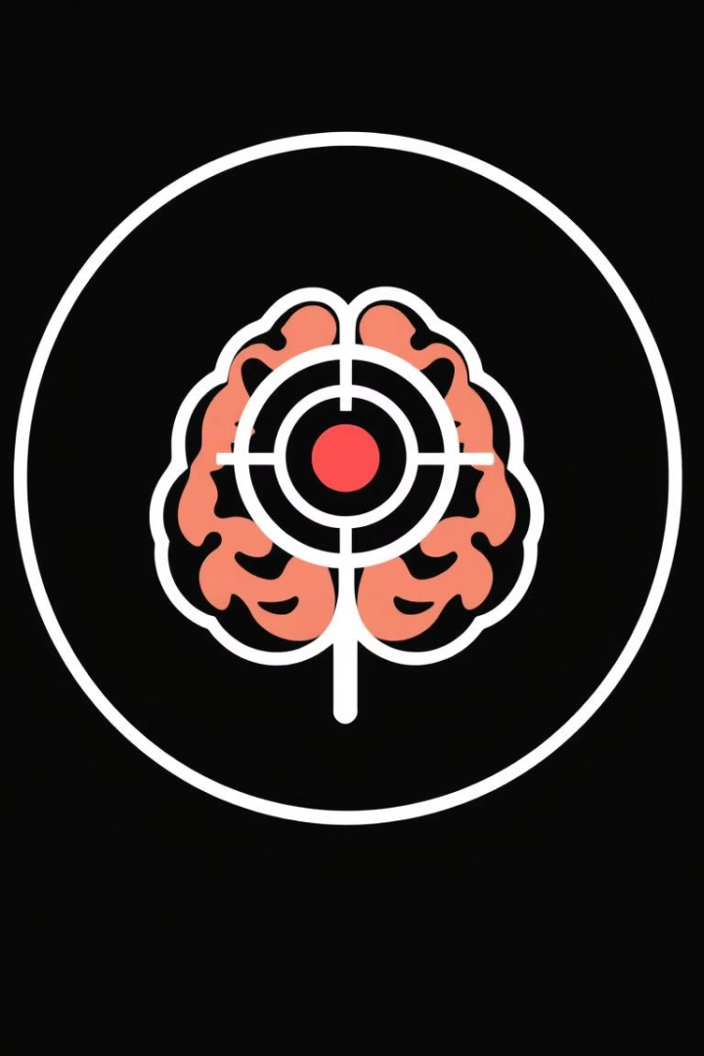


Objectives
Automated Detection
Classification
Develop an automated system for brain tumor detection, enhancing efficiency and reducing reliance on manual analysis.
Classify MRI images accurately as 'Tumor Detected' or 'No Tumor', providing a clear diagnosis for medical professionals.
Tumor Size Estimation
Medicine Suggestion
Suggest relevant medications based on tumor size and medical guidelines, streamlining treatment decisions.
Estimate tumor size to guide treatment planning and facilitate personalized medicine approaches.

Slide 6






Technologies Used
Python
TensorFlow/Keras
Programming language used for developing the entire system, from image processing to model training and deployment.
Deep Learning library used to build and train the Convolutional Neural Network model for tumor detection.
OpenCV
Flask
Open-source computer vision library used for image preprocessing and analysis, preparing MRI scans for the model.
Web framework used to develop the web application for user interaction and image upload.

Slide 7


Existing System
Supervised learning techniques with discriminative classifiers have been widely used for the accurate delineation of gliomas, with random forests (RF) and support vector machines (SVM) being among the most successful methods. These classifiers are trained on labelled MRI data to distinguish between different tumor grades effectively. A key approach in this system involves classifying brain tumor grades using superpixels generated from bi-modal MRI data, specifically FLAIR (Fluid-Attenuated Inversion Recovery) and T2-weighted MR images. These imaging modalities provide crucial contrast and structural details, enabling more precise segmentation and classification of gliomas. The use of superpixels helps in reducing computational complexity while preserving essential tumor-related features, improving the accuracy of classification models.

Slide 8

Existing System Drawbacks
Accuracy is Low
Medicine Not Suggested
No Nearby Hospitals
The current model's accuracy is not yet at a level suitable for clinical use. Further refinement is needed.
The system doesn't yet recommend specific medications. Future development aims to integrate this feature.
Hospital location services are not yet implemented. This will be added in future iterations.

Slide 9


Proposed System
Accuracy is High
The new model's accuracy is suitable for clinical use.
Will Suggest Medicine
The system recommend specific medications and nearby hospital.
Will Give Report
The new system will send report to the intended user Gmail.

Slide 10
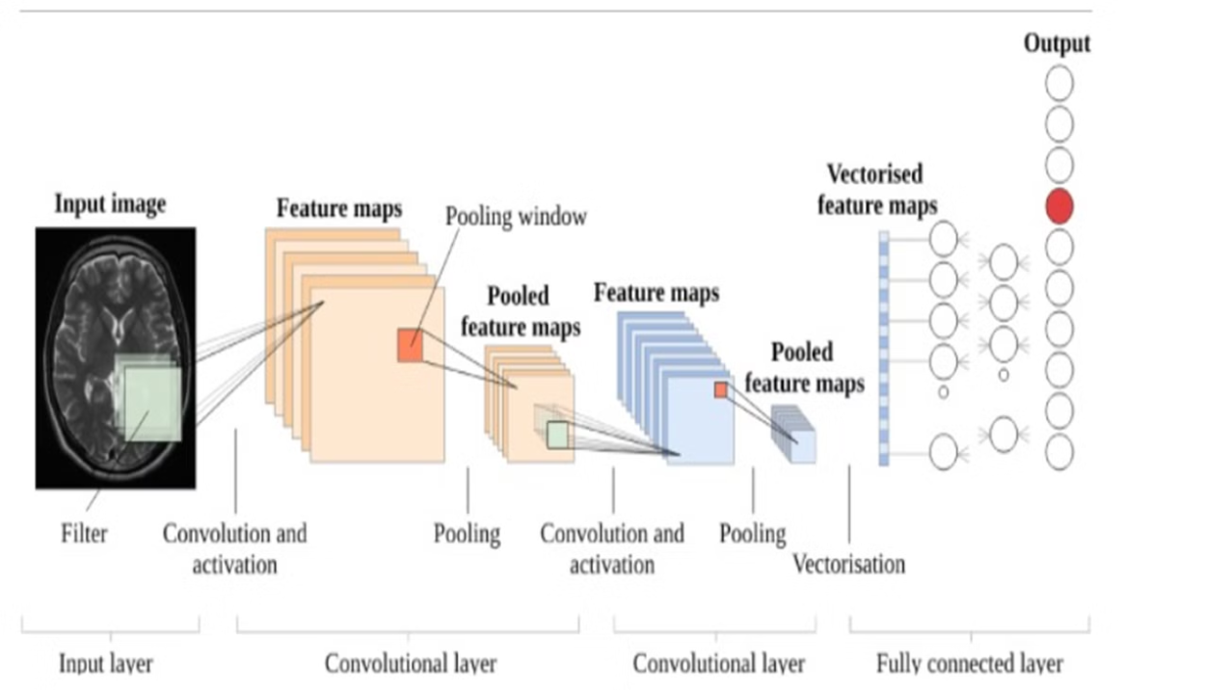


System Architecture

Slide 11


System Architecture
1
User Upload
A user uploads their MRI scan through the web application, initiating the detection process.
2
Image Preprocessing
OpenCV is used to preprocess the uploaded image, enhancing clarity and preparing it for analysis by the CNN.
3
CNN Prediction
The trained CNN model analyzes the preprocessed image, predicting whether a tumor is present or not.
4
Tumor Size Estimation
If a tumor is detected, the system estimates its size based on the CNN's analysis, providing further diagnostic information.
5
Medicine Suggestion
The system suggests relevant medications based on tumor size and medical guidelines, providing a personalized treatment recommendation.
6
Hospital Location
If a large tumor is detected, the system recommends nearby hospitals using OpenStreetMap's Overpass API, facilitating immediate medical attention.

Slide 12

Model Training & Accuracy
20%
80%
Training Data
Testing Data
The remaining 20% of the dataset was used to test the model's performance on unseen data, ensuring its ability to generalize to new MRI scans.
80% of the collected MRI data was used to train the CNN model, providing a comprehensive dataset for learning patterns and improving accuracy.
99%
Accuracy
The CNN model achieved a remarkable accuracy of 99% on the test dataset, demonstrating its effectiveness in detecting brain tumors.

Slide 13


Medicine Suggestion System
Small Tumor
1
For small tumors, Aspirin, a common pain reliever and anti-inflammatory, is suggested as a potential treatment option.
Medium Tumor
2
For medium-sized tumors, Dexamethasone, a steroid known for its anti-inflammatory and immune-suppressive properties, is recommended.
Large Tumor
3
In cases of larger tumors, Temozolomide, a chemotherapy drug specifically designed to target brain tumors, is suggested.
Very Large Tumor
4
For very large tumors, immediate hospitalization is recommended, allowing for advanced medical interventions and personalized treatment plans.

Slide 14





Hospital Locator Feature
OpenStreetMap API
Hospital Retrieval
Distance Calculation
The system leverages OpenStreetMap's Overpass API to access and retrieve information about nearby hospitals.
Based on the user's location, the system retrieves a list of hospitals within a specified radius, providing relevant options.
The system calculates the distance between the user's location and each retrieved hospital, providing a ranked list of nearest options.

Slide 15



Software Requirements
Python 3.7
Anaconda 3.7
PyCharm
The ideal version for this project.
A popular Python distribution for data science.
A robust IDE for Python development.
Jupyter Notebook
Google Colab
An interactive environment for code and documentation.
A cloud-based platform for Python programming.

Slide 16



Hardware Requirements
Operating System
Processor
Windows or Linux
Intel i3 or higher
RAM
Hard Disk
4 GB or more
250 GB or more

Slide 17


Base Reference Paper
Title:
Dataset Details:
A Comparative Analysis on Machine Learning-based Brain Tumor Detection Techniques
Source: Kaggle (Brain Tumor MRI Dataset)
The dataset consisted of 253 MRI images, split into 202 training images and 51 testing images. Images were preprocessed by resizing to 170x170 pixels, grayscale conversion, and normalization. Seven machine learning models were evaluated: Decision Tree, Decision Tree Regressor, Random Forest, Multi-Layer Perceptron (MLP), Stochastic Gradient Descent (SGD), Support Vector Machine (SVM), and k-Nearest Neighbors (KNN). The SVM model achieved the highest accuracy (86.80%).
Authors:
Harendra Negi, Bhawnesh Kumar, Aditya Bhatt, Sushil Dimri
Conference:
IEEE ICOEI 2023
DOI:
10.1109/ICOEI56765.2023.10125667
This study serves as a baseline for our research, and we aim to build upon its findings to develop a more robust and accurate brain tumor classification system. Improved preprocessing and additional features (e.g., medical reports) could further enhance model accuracy.

Slide 18
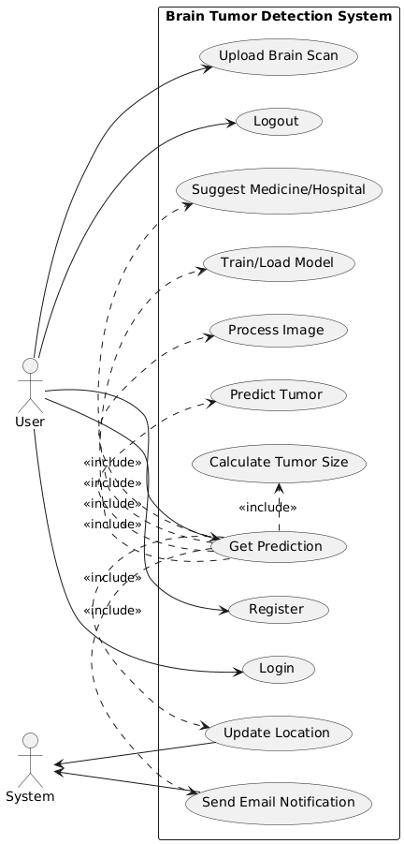
UML Use Case Diagram

Slide 19
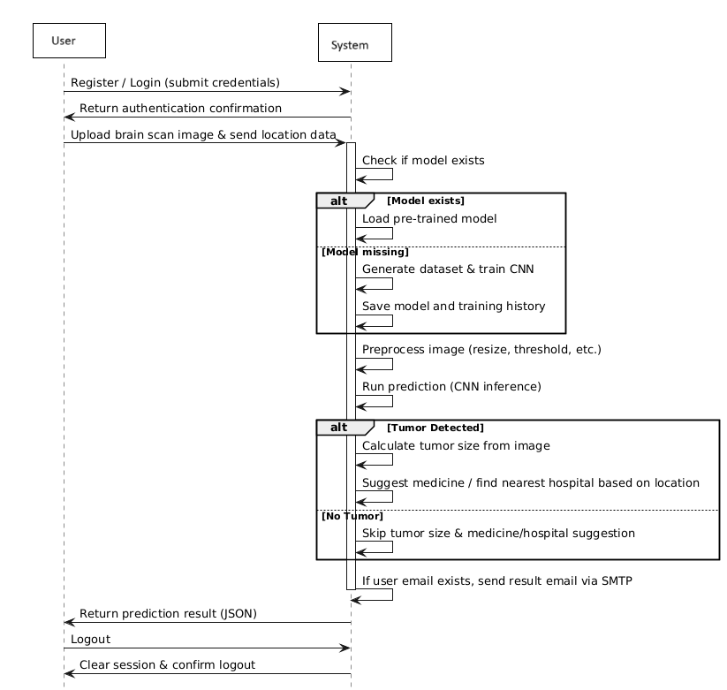

Slide 20
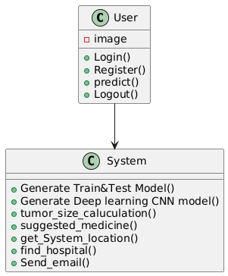
CLASS DIAGRAM

Slide 21
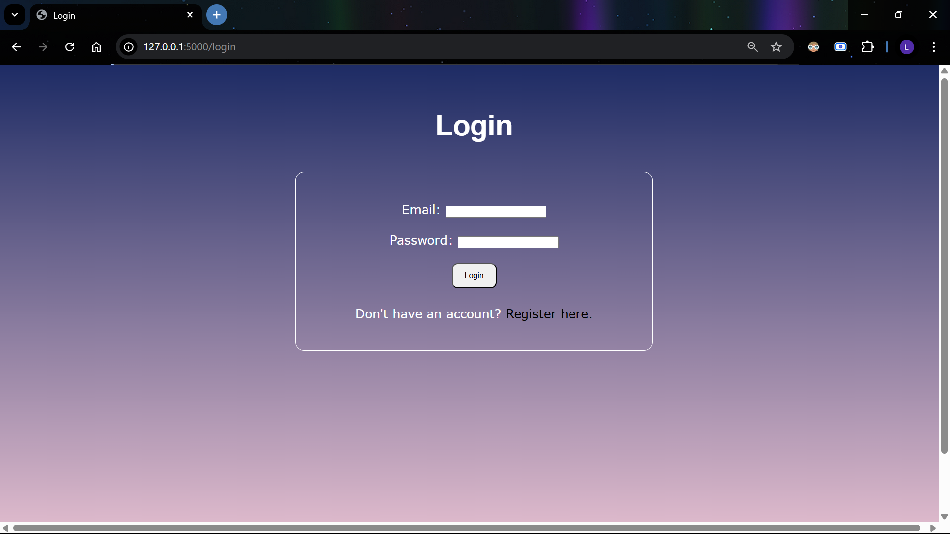


Screenshot's

Slide 22
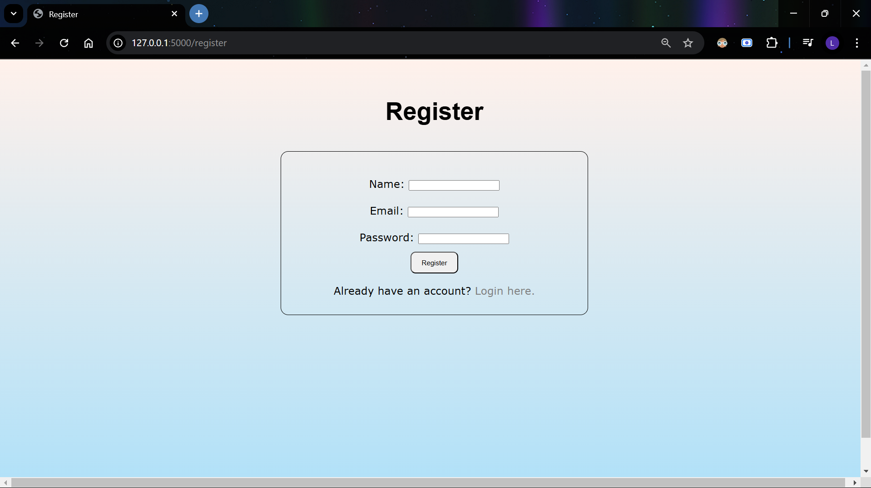


Slide 23
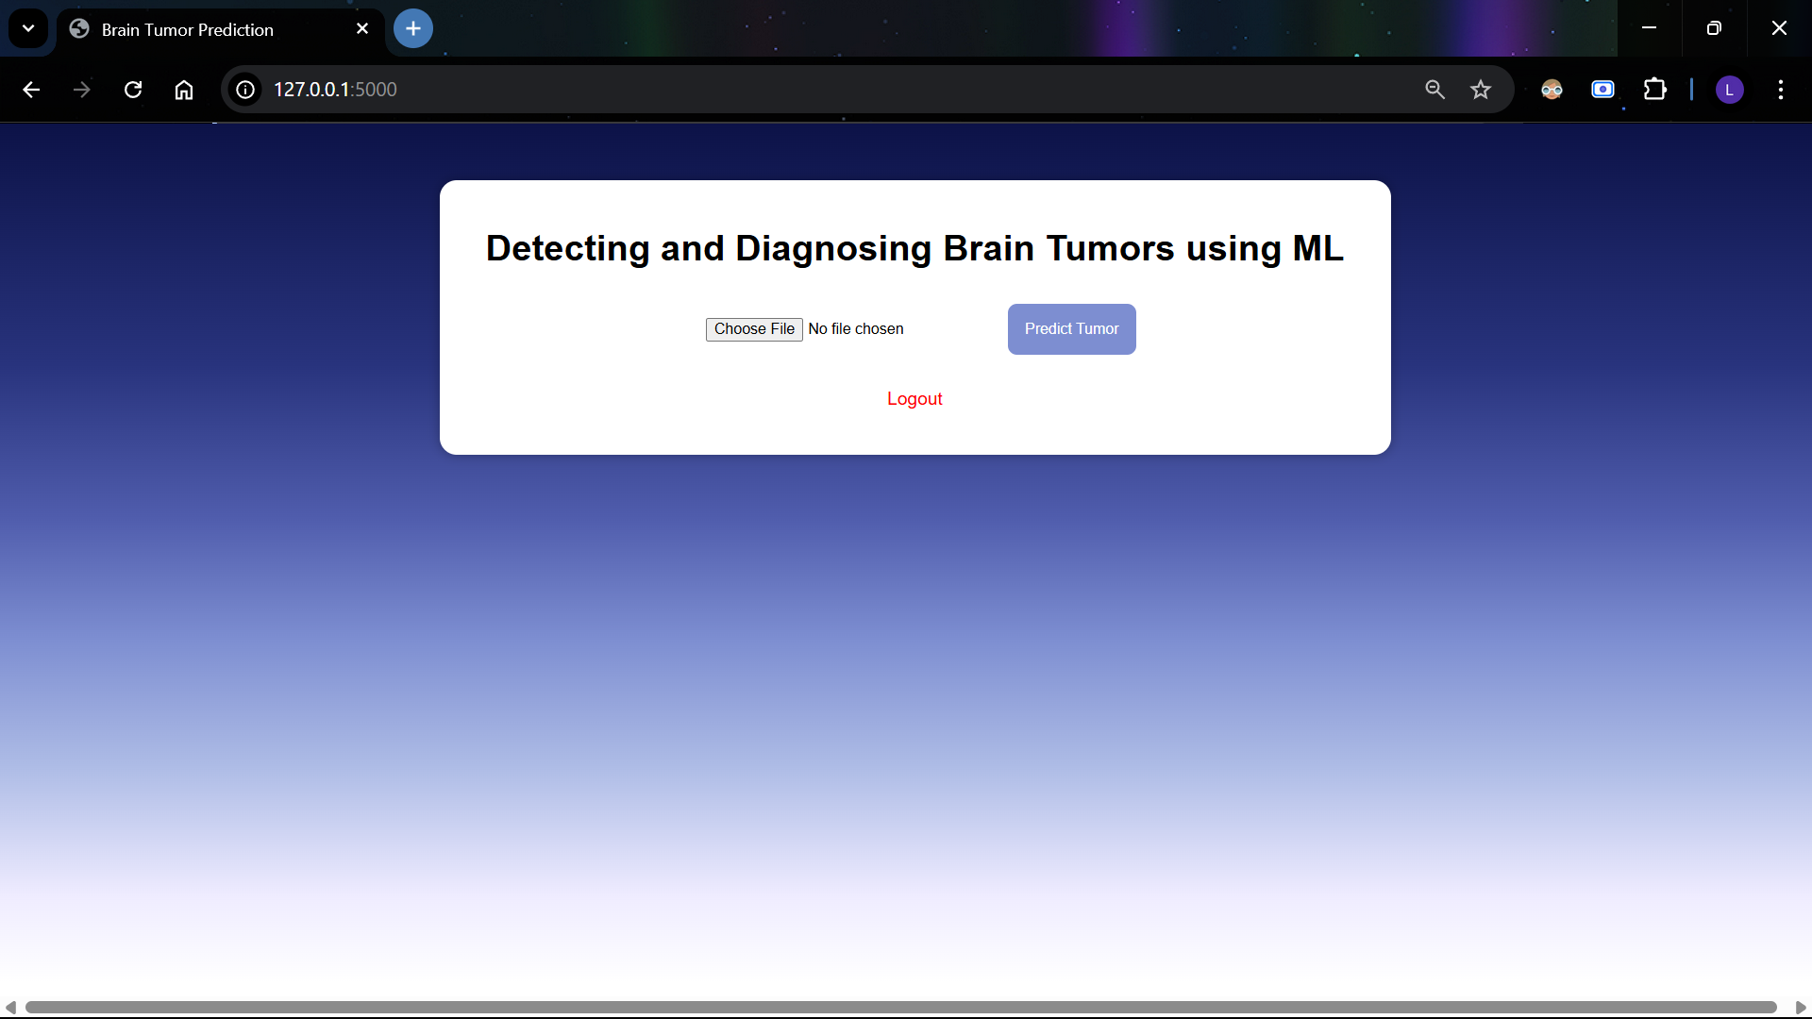



Slide 24
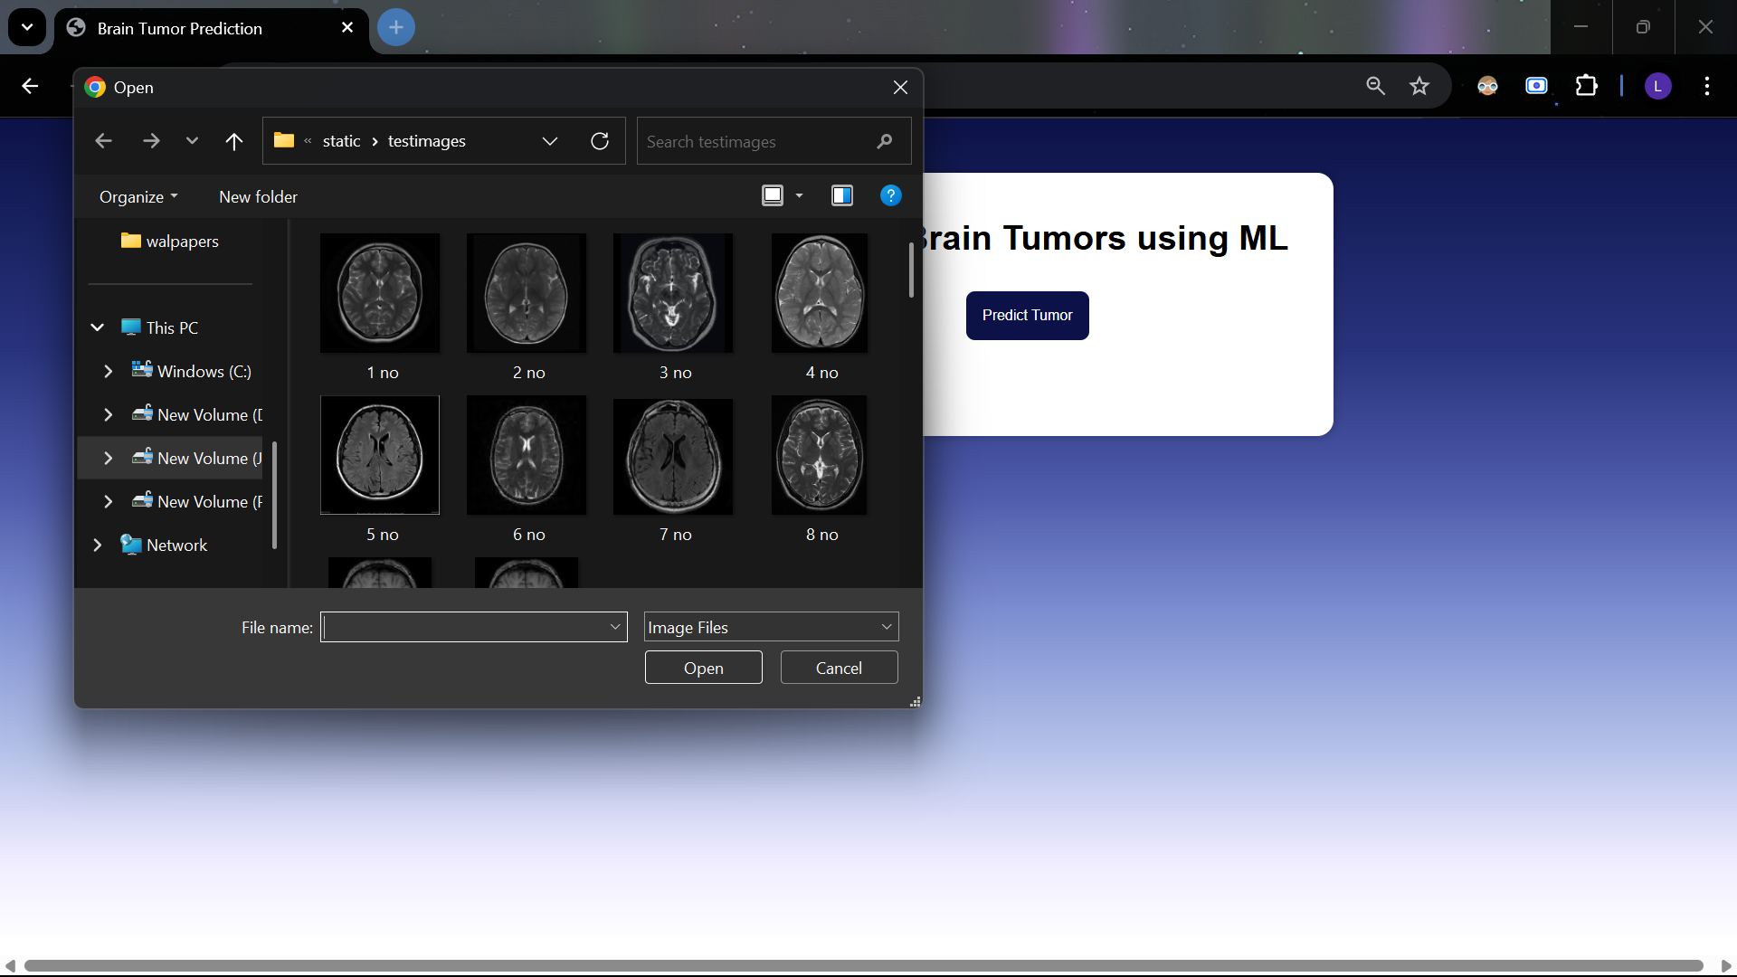






Slide 25
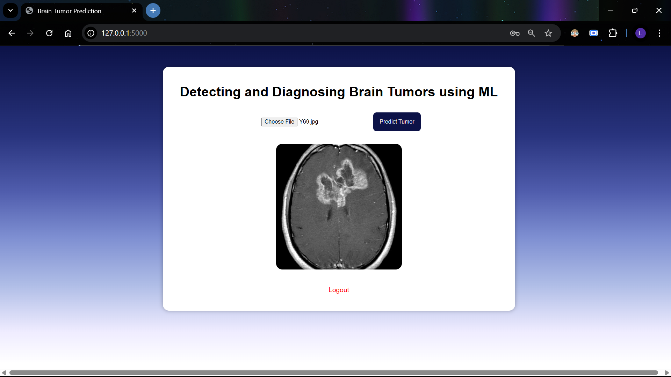


Slide 26
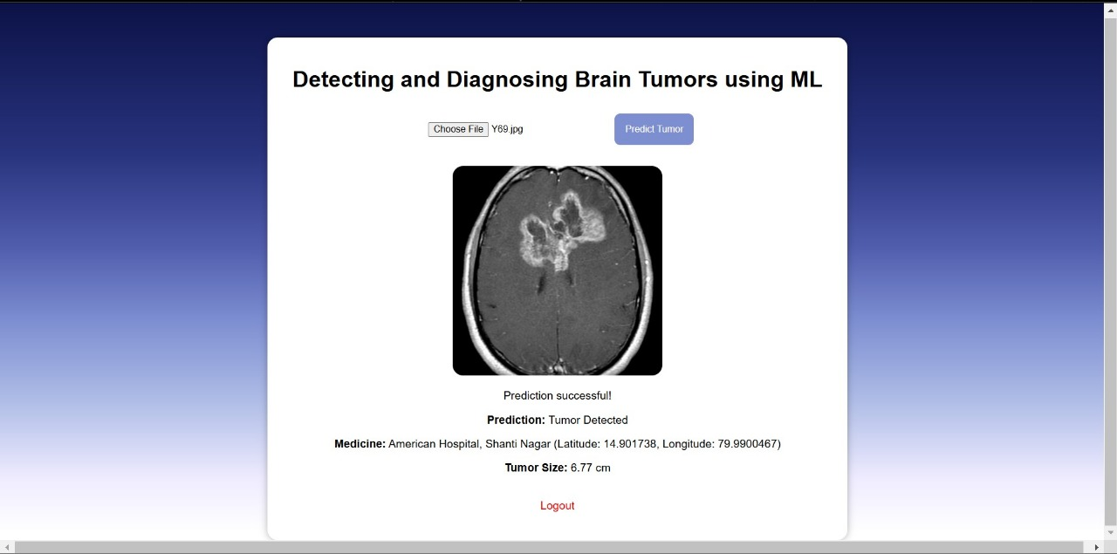





Slide 27
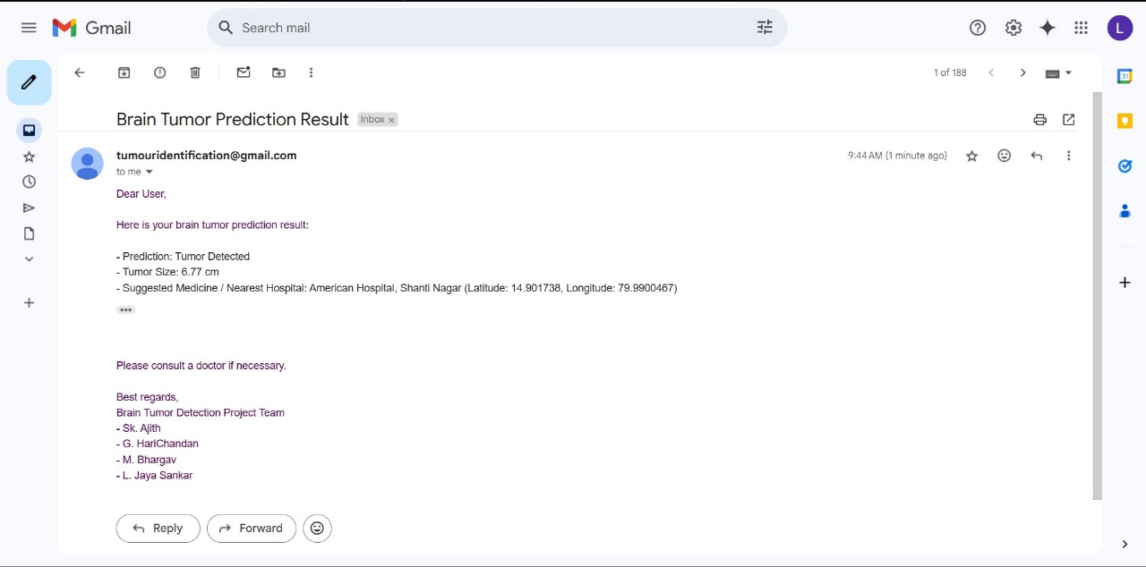

Slide 28

Conclusion
1
Tumor Detection
2
Tumor Classification
Successfully implemented a Convolutional Neural Network (CNN) model to detect brain tumors with high accuracy.
The system effectively classifies tumor types and provides accurate estimations of tumor size.
3
Patient Support
4
Early Diagnosis
Integrates medicine recommendation and hospital locator features to support patients in their journey.
This technology has the potential to aid in early diagnosis and guide patients towards appropriate medical care.

Slide 29



Thank You

